Slide 1
Predicting NBA Game Outcomes Using Supervised Machine Learning Models
Reginald McLean
James Zhou
Alykhan Sewani
Ali Aboubih

Slide 2
Contents
Introduction
Problem Statement and Datasets
Methods and Models
Results and Discussions
Conclusion/Next Steps

Slide 3
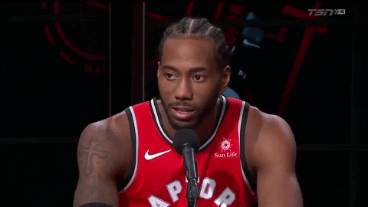
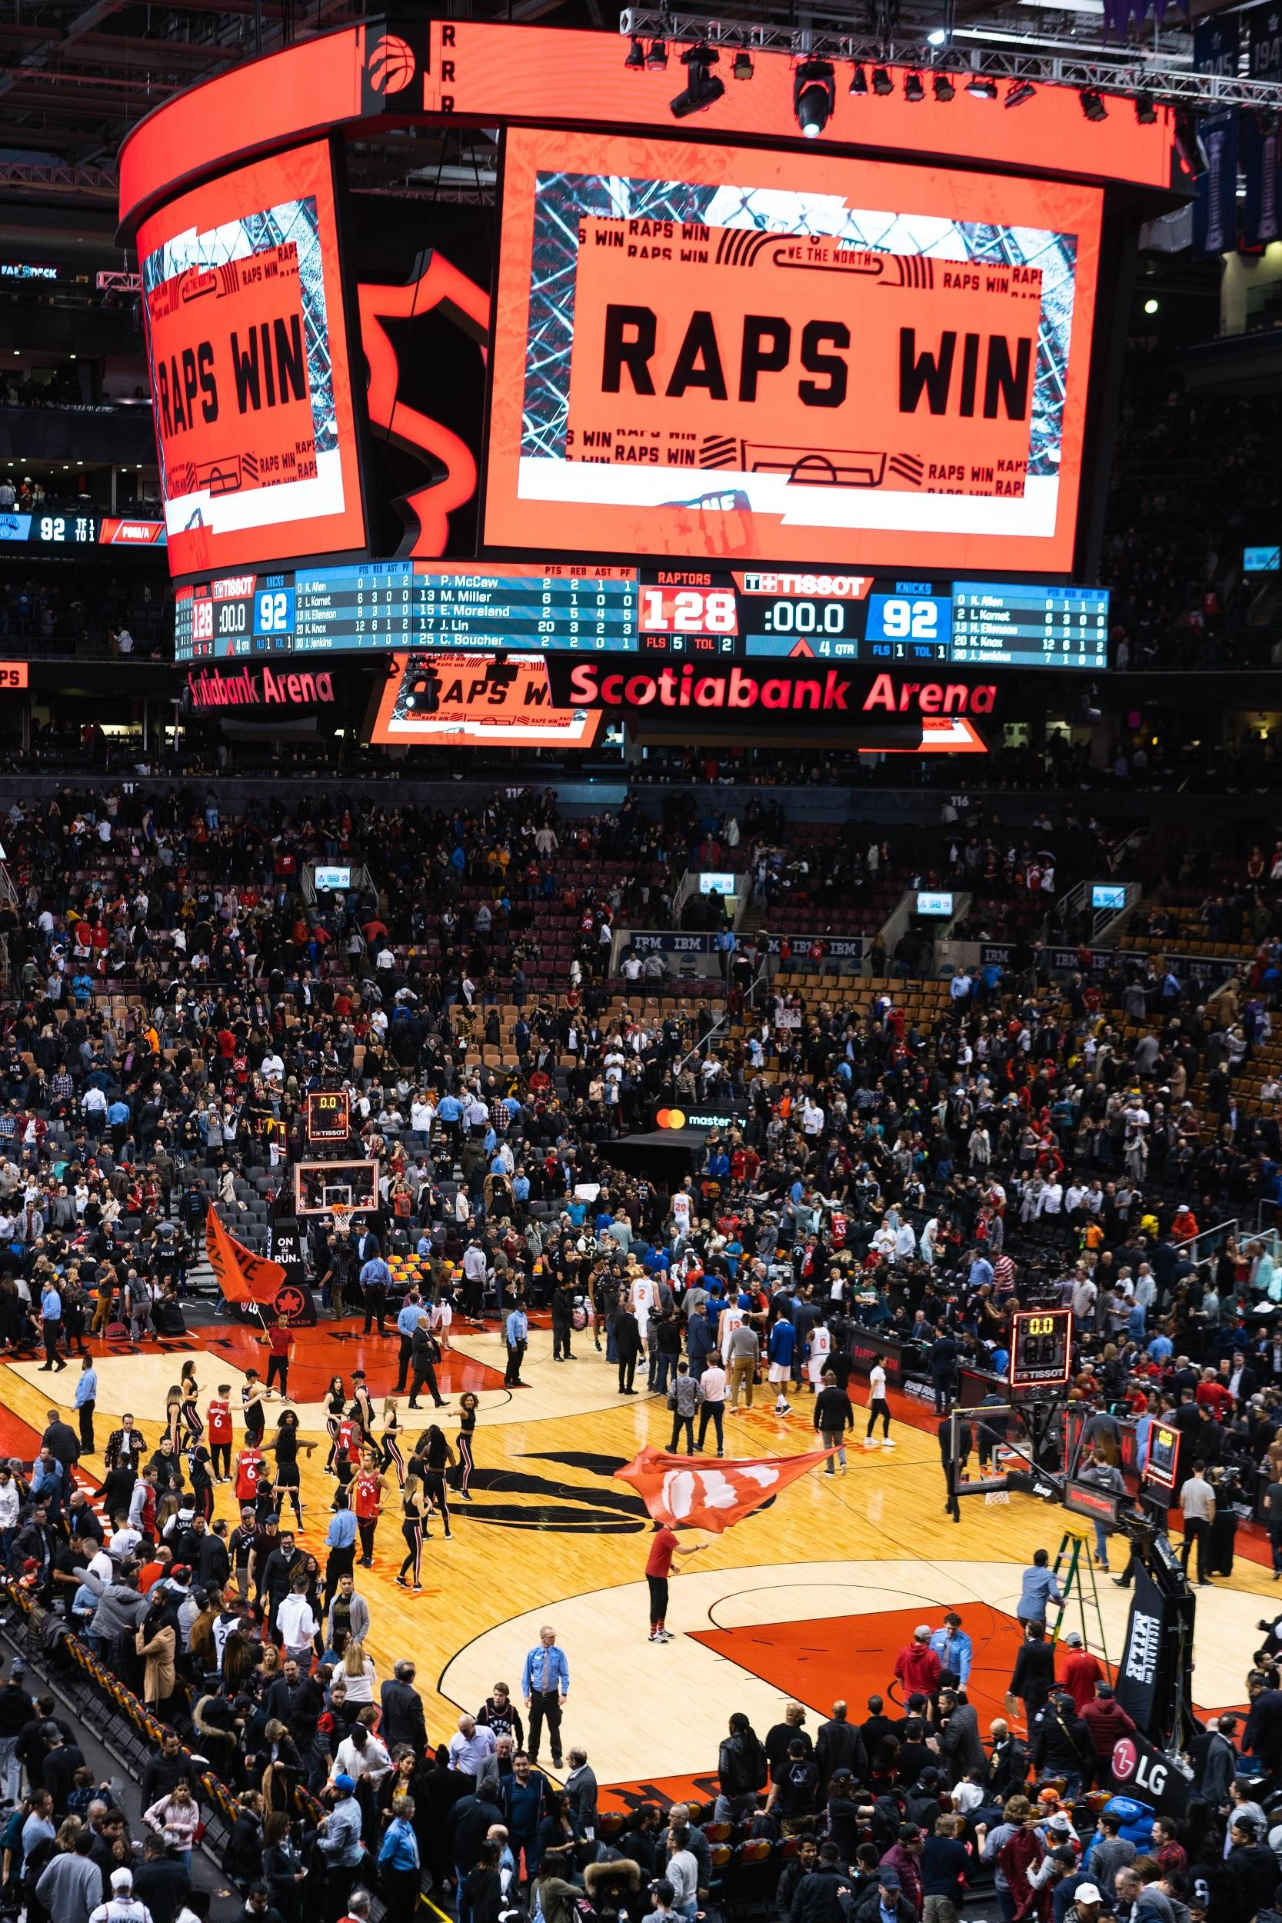
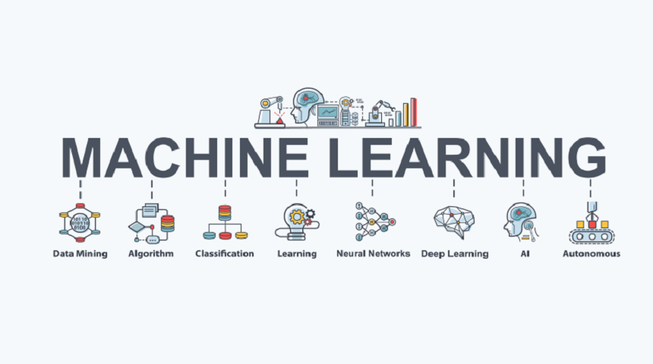
Introduction
Notes:
NBA Basketball is huuuuuge
Goal is to be able to use this system to make a lot of $$$$

Slide 4
Problem Statements and Datasets
Problem: Predict the outcome of NBA games
Data is from Kaggle
Advanced box score data from 2012-2018
Preprocessing included converting one line for home team, and one line for away team into one line that describes the two teams competing

Slide 5
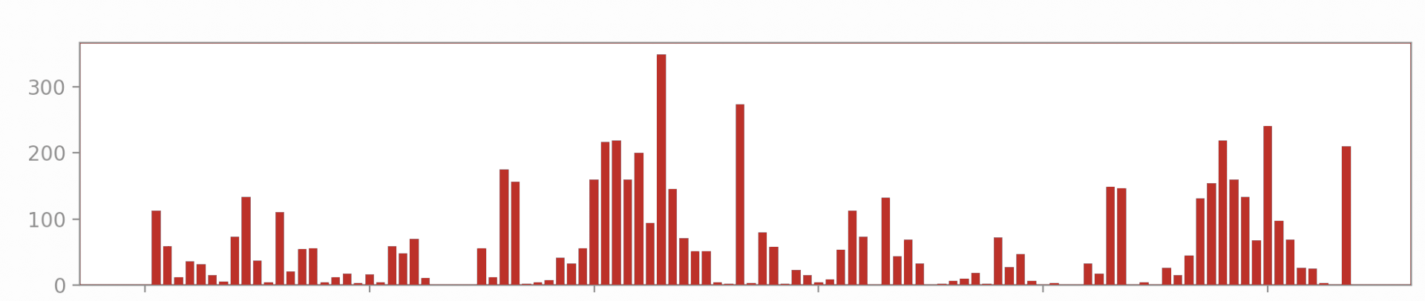
Methods and Models - Data Engineering and Feature Selection
rolling game average - 5, 10, and 15 games
ANOVA features selection
normalization

Slide 6
Methods and Models - Implementation
01
Hyperparameter Tuning
Relevant hyperparameters are identified
Optuna is used to determine optimum values
Objective: Maximize Validation Accuracy
02
Training/Validation Results
Model is trained on training set and makes predictions on training and validation sets
Process is run 10 times for statistical weight
Average accuracy and standard deviation is calculated
03
Bias-Variance Analysis
Training and Validation Accuracies are compared
Model adjusted to compensate for bias or variance
Ex. adding regularization to reduce bias
Steps 2-3 are repeated until satisfied
04
Final Results
Model is trained on training set and makes predictions on test set
Process is run 10 times for statistical weight
Average accuracy and standard deviation is calculated

Slide 7
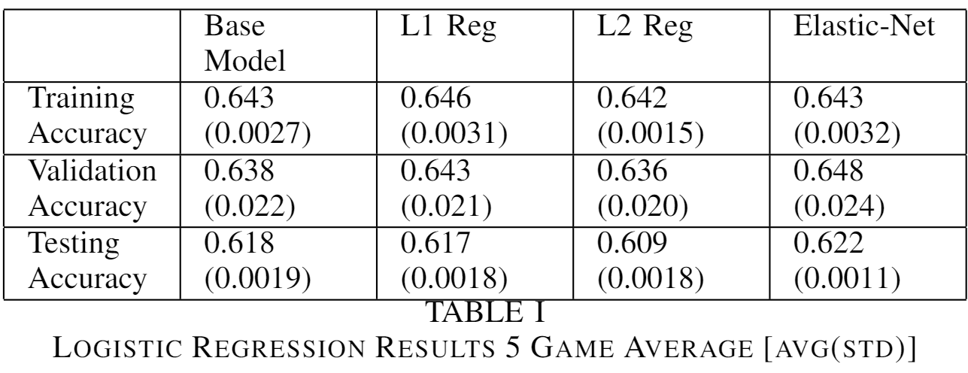
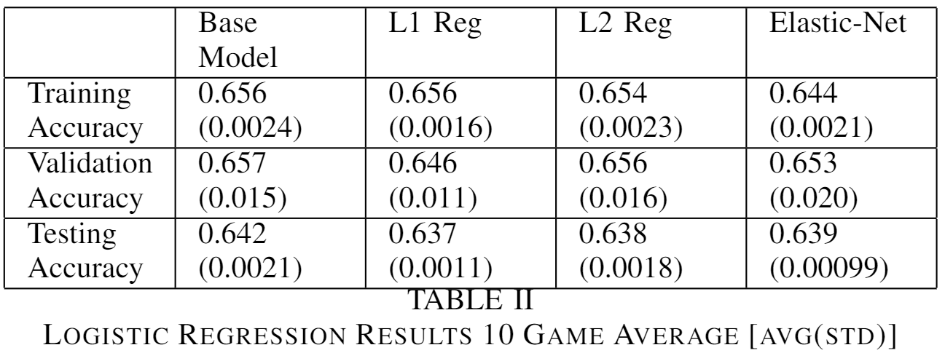
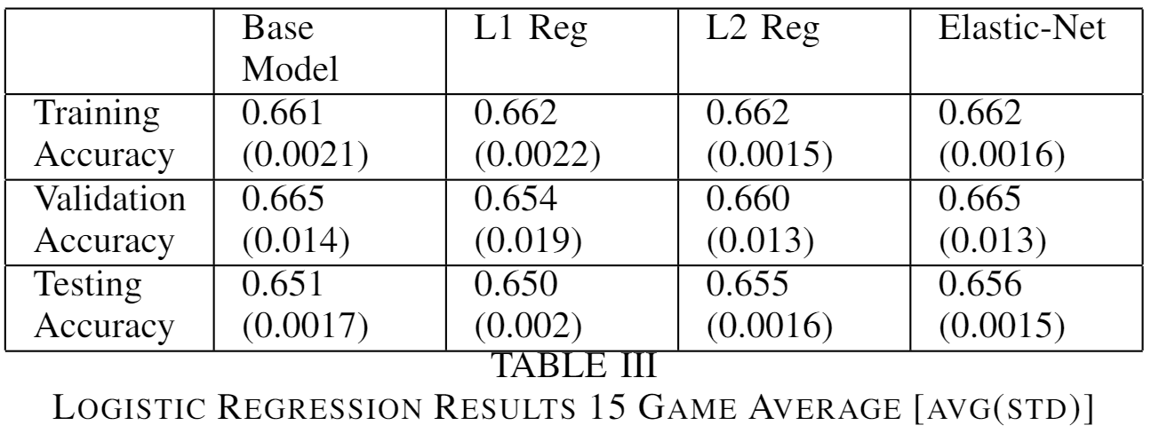
Model Results - Baseline Logistic Regression

Slide 8
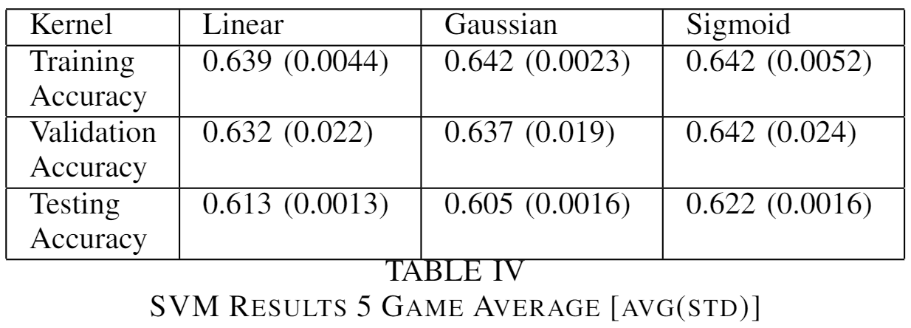
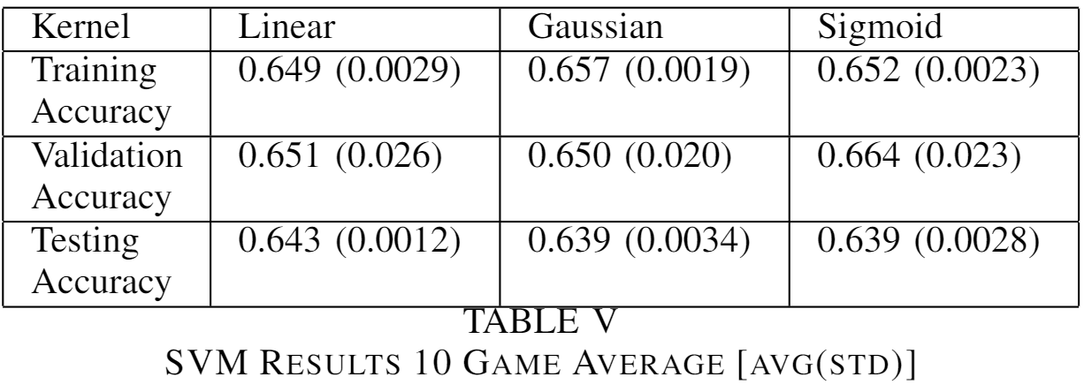

Model Results - SVM

Slide 9
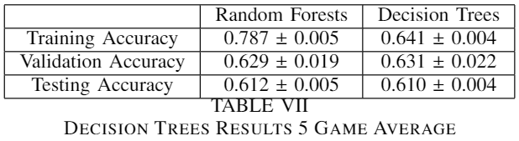
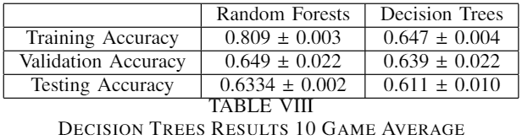
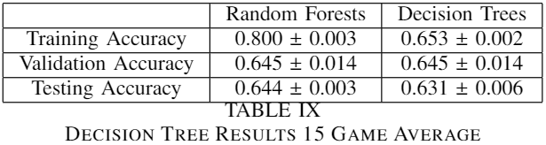
Model Results - Decision Trees

Slide 10
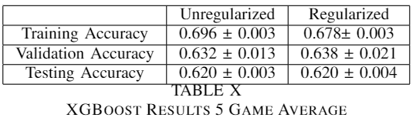
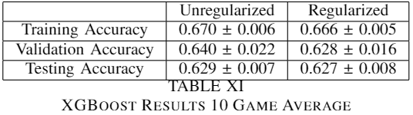
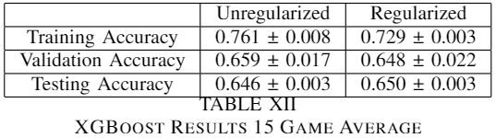
Model Results - XGBoost

Slide 11
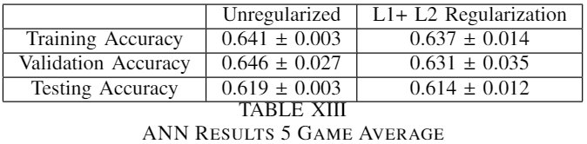
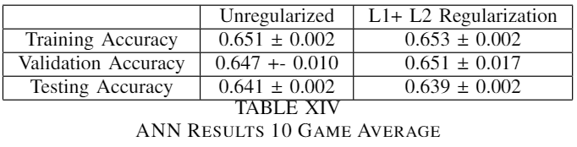
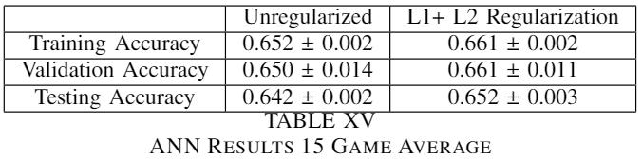
Model Results - ANN

Slide 12
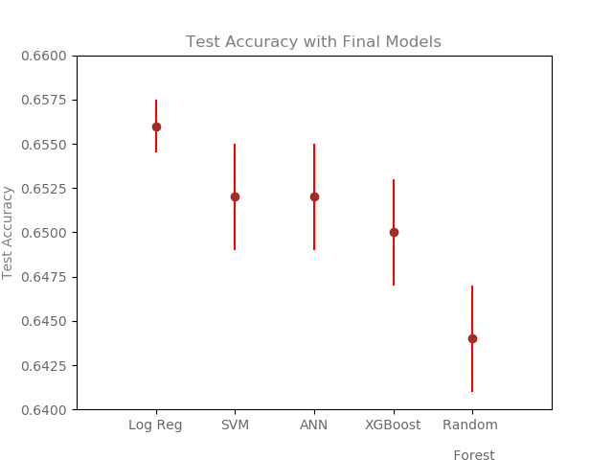
Test Accuracy Results

Slide 13
~65%
In our study, we were able to predict the game outcomes with about
accuracy.

Slide 14
Discussion
Initial attempt: Logistic Regression
Suffered from bias
Final Attempt: Implementing more complex models
SVM, Random Forest, XGBoost, ANN
Random Forest and XGBoost had lowest accuracies
Also suffered from overfitting
SVM and ANN had very similar accuracies
Still below baseline from logistic regression

Slide 15
Conclusion/Next Steps
Logistic Regression was the best
Multiple models were applied with various levels of regularization
Nothing could out perform Logistic Regression
New data
Combine player level data with team data
Train on year, test on next year
Train on regular season, test on playoffs
New models
Recurrent neural network, or long short term memory

Slide 16
